Slide 1
English For
Computer Science
Chapter 13 Computer Graphics
wxiaotian@jnu.edu.cn

Slide 2
13.1 Introduction To Computer Graphics
New Words & Expressions:
via 经，通过 conversation n. 会话，交谈
adage n. 谚语，格言 pervade 蔓延，遍及，扩大
diverse a. 不同的 encompass v. 包括，包含
adopt v. 采用，采纳 image n. 图像
classify vt. 分类 simulation n. 模拟，仿真
span v.横越，跨越 orthographic projections 八面图形投影法
perspective a. 透视的 Renaissance n. 文艺复兴
plot v. 绘图，划分 intractable a. 难解决的
Abbreviations:
CRT(Cathode-ray tube) 阴极射线管
LCD(Liquid Crystal Display) 液晶显示器
计算机专业英语
1-<number>

Slide 3
13.1 Introduction To Computer Graphics
The use of computer graphics pervades many diverse fields.
Applications range from the production of charts and graphs, to the generation of realistic images for television and motion pictures to the interactive design of mechanical parts.
To encompass all these uses, we can adopt a simple definition:
Computer graphics is concerned with all aspects of using a computer to generate images.
计算机图形学的应用扩展到了许多不同领域，应用的范围从表和图形的产生，到用于电视和动画片的真实图像的生成，到机械零件的交互式设计。我们采用一个简单的定义来概括所有这些应用：
“计算机图形学主要研究采用计算机生成图像的所有方面。”
计算机专业英语
1-<number>

Slide 4
13.1 Introduction To Computer Graphics
We can classify applications of computer graphics into four main areas:
· Display of information
· Design
· Simulation
· User interfaces
我们可以把计算机图形学的应用分作四个主要方面：
· 信息显示、 设计、 模拟、· 用户界面
计算机专业英语
1-<number>

Slide 5
13.1 Introduction To Computer Graphics
13.1.1 Display of information
Graphics has always been associated with the display of information.
Examples of the use of orthographic projections to display floorplans of buildings can be found on 4000-year-old Babylonian stone tablets.
Medical imaging uses computer graphics in a number of exciting ways.
13.1.1 信息显示
图形总是和信息显示相联系的。4000年以前在巴比伦发现了在石桌上用八面图形投影法去表现建筑平面设计图的例子。
医学图像也运用计算机图形学解决了大量难题。
计算机专业英语
1-<number>

Slide 6
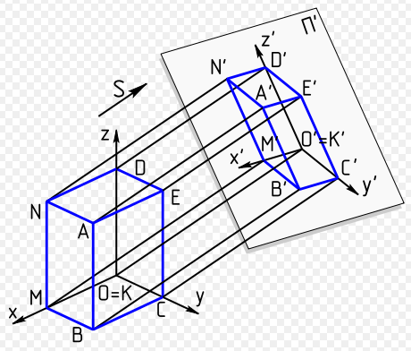
Example of orthographic projections
计算机专业英语
1-<number>

Slide 7
13.1 Introduction To Computer Graphics
13.1.2 Design (Computer-Aided Design, CAD)
Professions such as engineering and architecture are concerned with design.
Although their applications vary, most designers face similar difficulties and use similar methodologies.
工程和建筑的专业人员关心设计，尽管他们的应用不同，但大多数设计者面对相似的困难，采用了类似的方法。
计算机专业英语
1-<number>

Slide 8
13.1 Introduction To Computer Graphics
13.1.2 Design (Computer-Aided Design, CAD)
One of the principal characteristics of most design problems is the lack of a unique solution.
Hence, the designer will examine a potential design and then will modify it, possibly many times, in an attempt to achieve a better solution.
Computer graphics has become an indispensable element in this iterative process.
大多数设计问题的基本特点之一是缺少唯一的解决方案，
因此，设计者可能需要多次检查原来的设计，修改它，以获得一个更好的解决方案。
在这个重复的过程中，计算机图形学已变成一个不可缺少的部分。
计算机专业英语
1-<number>

Slide 9
13.1 Introduction To Computer Graphics
13.1.3 Simulation
Some of the most impressive and familiar uses of computer graphics can be classified as simulations.
Video games demonstrate both the visual appeal of computer graphics and our ability to generate complex imagery in real time.
The insides of an arcade game reveal state-of-the-art hardware and software.
13.1.3 模拟
最为人所知的计算机图形学应用可归为模拟类。视频游戏展示了计算机图形学的视觉魅力和我们实时生成复杂图像的能力。走廊游戏的内容揭示了当前软件和硬件的技术发展水平。
计算机专业英语
1-<number>

Slide 10
13.1 Introduction To Computer Graphics
13.1.3 Simulation
Computer-generated images are also the heart of flight simulators, which have become the standard method for training pilots.
The savings in dollars and lives realized from use of these simulators has been enormous.
The computer-generated images we see on television and in movies have advanced to the point that they are almost indistinguishable from real-world images.
13.1.3 模拟
计算机生成的图像是飞行模拟器的核心，已经成为训练飞行员的标准方法，这种模拟训练大大节省了人力物力。我们在电视和电影中看到的计算机生成的图像已经达到了和真实图像几乎无法区分的地步。
计算机专业英语
1-<number>

Slide 11
13.1 Introduction To Computer Graphics
13.1.4 User Interfaces
The interface between the human and the computer has been radically altered by the use of computer graphics. Consider the electronic office.
The figures in this book were produced through just such an interface. A secretary sits at a workstation, rather than at a desk equipped with a typewriter.
This user has a pointing device, such as a mouse, that allows him to communicate with the workstation.
计算机图形学的应用已经根本改变了人和计算机之间的界面。讨论一下电子办公室，本书的图是由这样的界面产生的，秘书坐在工作站前，而不是备有打字机的办公桌前，这一用户有一个指示设备(如鼠标)实现他和工作站之间的交互。
计算机专业英语
1-<number>

Slide 12
13.1 Introduction To Computer Graphics
13.1.4 User Interfaces
The display consists of a number of icons that represent the various operations the secretary can perform.
For example, there might be an icon of a mailbox that ,if pointed to and clicked on ,causes any electronic-mail messages to appear on the screen.
显示由许多图符组成，代表秘书可进行的各种操作，例如，有一个邮箱图符，如果指向并点击它，屏幕上将会显示电子邮件信息.
计算机专业英语
1-<number>

Slide 13
13.2 Video Display Devices
New Words & Expressions:
video monitor 视频监视器 solid-state 固态(使用电晶体不用真空管)的
predominant 支配的 raster-scan display 光栅扫描显示器
frame buffer 帧缓冲器 intensity n. 强度
pixel (or pel) n. 像素 resolution n. 分辨率
bitmap n. 位图 random-scan display 随机扫描显示器
vector 矢量，向量 hard-copy device 硬拷贝设备
pen plotter 笔式绘图仪 flat-panel displays 平板显示器
rugged 粗糙的，要求不高的
Abbreviations :
CRT（cathode-ray-tube） 阴极射线管
DVST（Direct-View Storage Tube） 直视存储管
计算机专业英语
1-<number>

Slide 14
13.2 Video Display Devices
Raster-Scan Displays
The most common type of graphics monitor employing a CRT is the raster-scan display, based on television technology.
In a raster-scan system, the electron beam is swept across the screen, one row at a time from top to bottom.
As the electron beam moves across each row, the beam intensity is turned on and off to create a pattern of illuminated spots.
光栅扫描显示器
使用CRT的普通图形监视器是基于电视技术的光栅扫描显示器。在光栅扫描系统中，电子束横向扫描屏幕，一次一行，从顶到底依次进行。当电子束沿横向逐行移动时，电子束的强度不断变化，从而建立亮点的可显示模式。
计算机专业英语
1-<number>

Slide 15
13.2 Video Display Devices
Raster-Scan Displays
Picture definition is stored in a memory area called the refresh buffer or frame buffer.
This memory area holds the intensity values (brightness) for all the screen points.
Stored intensity values are then retrieved from the frame buffer and “ painted” on the screen one row (scan line) at a time.
图形定义保存在称为刷新缓冲器或帧缓冲器的存储器中。
该存储器保存一组对应屏幕所有点的强度值。然后再从刷新缓冲器取出存储的强度值，并在屏幕上逐行（扫描行）画出。
计算机专业英语
1-<number>

Slide 16
13.2 Video Display Devices
Raster-Scan Displays
Each screen point is referred to as a pixel or pel (shortened forms of picture element).
The capability of a raster-scan system to store intensity information for each screen point makes it well suited for the realistic display of scenes containing subtle shading and color patterns.
Home television sets and printers are examples of other systems using raster-scan methods.
每个屏幕点作为一个像素。光栅扫描系统对于屏幕每一点都有存储强度信息的能力，从而使之较好地适用于包含细微阴影和彩色模式的场景的逼真显示。家用电视和打印机是另一类使用光栅扫描方式的例子。
计算机专业英语
1-<number>

Slide 17
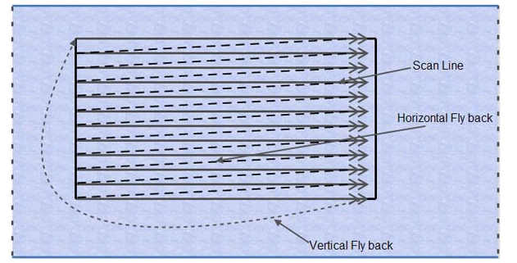
计算机专业英语
1-<number>

Slide 18
13.2 Video Display Devices
Random-Scan Displays
When operated as a random-scan display unit, a CRT has the electron beam directed only to the parts of the screen where a picture is to be drawn.
Random-scan monitors draw a picture one line at a time and for this reason are also referred to as a vector displays（or stroke-writing or calligraphic displays）.
随机扫描显示器
当使用随机扫描显示器时，CRT的电子束只在屏幕的图形部分移动。随机扫描显示器一次只绘制图形中的一条线，因此也称为向量显示器（或笔划显示器，或笔迹显示器）。
计算机专业英语
1-<number>

Slide 19
13.2 Video Display Devices
Random-Scan Displays
The component lines of a picture can be drawn and refreshed by a random-scan system in any specified order.
A pen plotter operates in a similar way and is an example of a random-scan, hard-copy device.
随机扫描显示器
图形的组成线条由随机扫描系统按任意指定的顺序绘制并刷新。笔式绘图仪也以类似的方式工作，它是随机扫描、硬拷贝设备的一个例子。
计算机专业英语
1-<number>

Slide 20
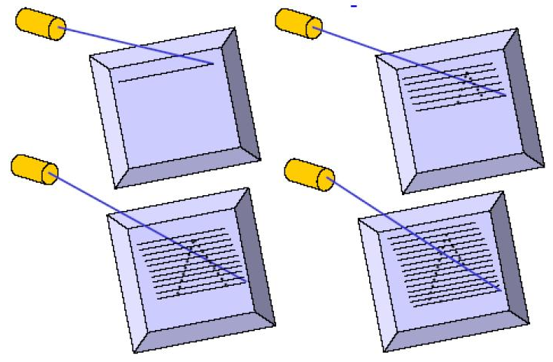
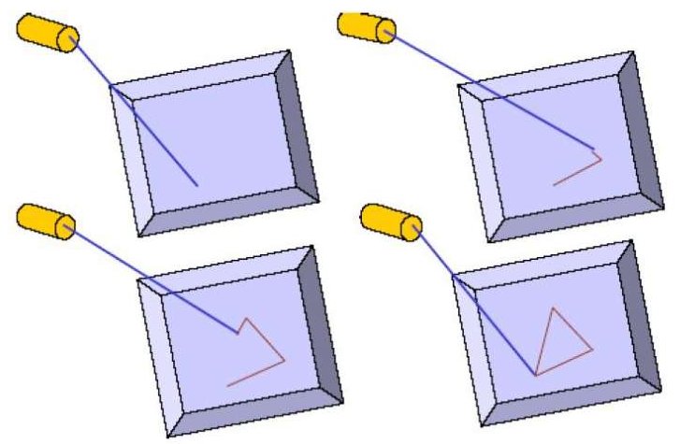
Raster-Scan Displays Random-Scan Displays
计算机专业英语
1-<number>

Slide 21
13.2 Video Display Devices
Direct-View Storage Tubes
An alternative method for maintaining a screen image is to store the picture information inside the CRT instead of refreshing the screen.
A direct-view storage tube (DVST) stores the picture information as a charge(电荷) distribution just behind the phosphor(荧光剂)-coated(覆盖) screen.
直视存储管
保持屏幕图形的另一种方法是把图形信息存储在CRT内，而不再是刷新屏幕。直视存储管(DVST)通过紧贴在屏幕荧光层后的电荷分布来存储图形信息。
计算机专业英语
1-<number>

Slide 22
13.2 Video Display Devices
Direct-View Storage Tubes
Two electron guns are used in a DVST. One, the primary gun, is used to store the picture pattern; the second, the flood gun, maintains the picture display.
直视存储管
DVST使用两支电子枪。一支是基本枪，用来存储图形图案；另一支是泛流枪，用来保持图形显示。
计算机专业英语
1-<number>

Slide 23
13.2 Video Display Devices
Flat-Panel Displays
The term flat-panel display refers to a class of video devices that have reduced volume, weight, and power requirements compared to a CRT.
A significant feature of flat-panel displays is that they are thinner than CRTs, and we can hang them on walls or wear them on our wrists.
平板显示器
平板显示器代表一类能比CRT减少体积、减轻重量并节省功耗的视频设备。平板显示器的一个有意义的特性是比CRT要薄，可把它们挂在墙上或戴在手腕上。
计算机专业英语
1-<number>

Slide 24
13.2 Video Display Devices
Flat-Panel Displays
Since we can even write on some flat-panel displays, they will soon be available as pocket notepads.
Current uses for flat-panel displays include small TV monitors, calculators, pocket video games, laptop computers, armrest(扶手) viewing of movies on airlines, as advertisement boards in elevators, and as graphics displays in applications requiring rugged, portable monitors.
平板显示器
因为有些平板显示器上甚至可以书写，不久它们即可作为袖珍式笔记本。
平板显示器目前的应用包括小型TV监视器、计算器、袖珍式视频游戏机、折叠式计算机、航空座椅上的电影屏幕、电梯内的告示牌，以及在要求不高的便携式监视器的应用场合中，作为图形显示器。
计算机专业英语
1-<number>

Slide 25
13.3 Output Primitives
New Words & Expressions
output primitives 输出图元 analog device 模拟设备
vector n. 矢量 pen plotter 笔式绘图仪
random-scan display 随机扫描显示器 endpoint n. 端点
horizontal a. 水平的 vertical a. 垂直的
deflection n. 偏转，偏差 voltage n. 电压，伏特数
digital device 数字设备 high-resolution 高分辨率的
计算机专业英语
1-<number>

Slide 26
13.3 Output Primitives
Typically, graphics programming packages provide functions to describe a scene in terms of these basic geometric structures, referred to as output primitives, and to group sets of output primitives into more complex structures.
Each output primitive is specified with input coordinate data and other information about the way that the object is to be displayed.
通常，图形编程软件包提供了一些功能来描述场景，这些功能使用了称为输出图元的基本几何结构并将输出图元组合成更复杂的结构。
每个输出图元是由输入的坐标数据和有关物体显示的一些信息来指定。
计算机专业英语
1-<number>

Slide 27
13.3 Output Primitives
Points and straight-line segments are the simplest geometric components of pictures.
Additional output primitives that can be used to construct a picture include circles and other conic sections, quadric surfaces, spline curves and surfaces, polygon color areas, and character strings.
点和直线是最简单的几何成分，其它可以用来构造图形的输出图元有：圆及其它圆锥曲线、二次曲面、样条曲线和曲面、多边形填色区域以及字符串等。
计算机专业英语
1-<number>

Slide 28
13.3 Output Primitives
Points and Lines
Point plotting is accomplished by converting a single coordinate position furnished by an application program into appropriate operations for the output device in use.
With a CRT monitor, for example, the electron beam is turned on to illuminate the screen phosphor at the selected location. How the electron beam is positioned depends on the display technology.
点和线
通过将应用程序提供的单个坐标位置转换成输出设备的相应操作，可以进行点的绘制。例如，对于CRT监视器，则是打开电子束，从而在选中的位置上照亮屏幕的荧光层。电子束的定位方法取决于显示技术。
计算机专业英语
1-<number>

Slide 29
13.3 Output Primitives
Points and Lines
Line drawing is accomplished by calculating intermediate positions along the line path between two specified endpoint positions.
An output device is then directed to fill in these positions between the endpoints. For analog devices, such as a vector pen plotter or a random-scan display, a straight line can be drawn smoothly from one endpoint to the other.
通过计算沿线路径上两指定端点间的中间位置，可以绘制一条线段，输出设备则按指令在端点间的这些位置直接填充。对于笔式绘图仪或随机扫描显示器这类模拟设备，可以从一个端点至另一端点绘制光滑线段。
计算机专业英语
1-<number>

Slide 30
13.3 Output Primitives
翻译练习：
Linearly varying horizontal and vertical deflection voltages are generated that are proportional to the required changes in the x and y directions to produce the smooth line.
这是根据x方向和y方向需要修改的实际量，线性地改变水平和垂直偏转电压而实现的。
计算机专业英语
1-<number>

Slide 31
13.3 Output Primitives
Points and Lines
To load a specified color into the frame buffer at a position corresponding to column x along scan line y, we will assume we have available a low-level procedure of the form
SetPixel (x, y)
为了将对应于扫描线y、列x的位置上指定的颜色装入帧缓冲器，我们假设有如下形式的低层程序：
SetPixel (x, y)
计算机专业英语
1-<number>

Slide 32
13.3 Output Primitives
Points and Lines
We sometimes will also want to be able to retrieve the current frame-buffer intensity setting for a specified location. We accomplish this with the low-level function
GetPixel (x, y)
有时，我们也要求能提取某个特定位置上当前帧缓冲器的强度设置，可以使用下列低层函数来完成：
GetPixel (x, y)
计算机专业英语
1-<number>

Slide 33
13.3 Output Primitives
FILL-AREA FUNCTIONS
We display a filled polygon in PHIGS and GKS with the function
fillArea (n, wcVertices)
The displayed polygon area is bounded by a series of n straight line segments connecting the set of vertex positions specified in wcVertices. These packages do not provide fill functions for objects with curved boundaries.
区域填充函数
在PHIGS和GKS中，利用下列函数显示填充的多边形：
fillArea (n, wcVertices)
显示的多边形区域，由一系列在wcVertices中指定的顶点连接起来的n条直线段包围。这些软件包没有提供曲线边界对象的填充功能。
计算机专业英语
1-<number>

Slide 34


13.3 Output Primitives
Types of Conic Sections（圆锥曲线）：
General Conic Sections
The Circle
The Ellipse （椭圆）
The Parabola （抛物线）
The Hyperbola （双曲线）
Lines and Points: Degenerate (退化) Conic Sections
计算机专业英语
1-<number>

Slide 35
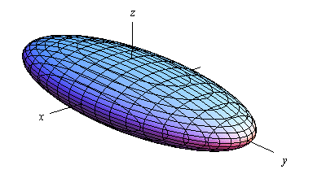
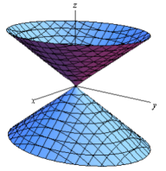
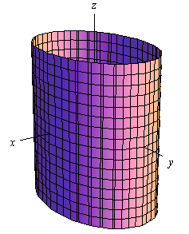
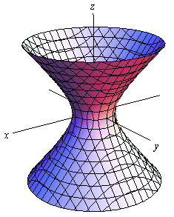
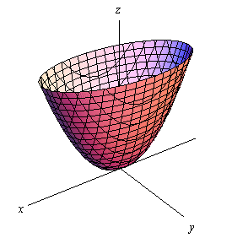
13.3 Output Primitives
Types of Quadric Surfaces（二次曲面） ：
General Form
The Ellipsoid （椭圆体，椭球）
The Cone （圆锥体）
The Cylinder （圆柱体）
The Hyperboloid （双曲面）
The Elliptic Paraboloid （椭圆抛物面）
计算机专业英语
1-<number>

Slide 36
13.3 Output Primitives
Spline curves
A spline curve is a mathematical representation for which it is easy to build an interface that will allow a user to design and control the shape of complex curves and surfaces.
The general approach is that the user enters a sequence of points, and a curve is constructed whose shape closely follows this sequence.
The points are called control points.
计算机专业英语
1-<number>

Slide 37
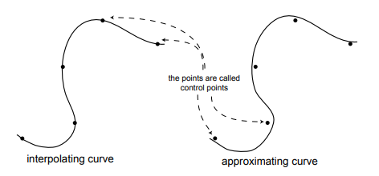
13.3 Output Primitives
Spline curves
A curve that actually passes through each control point is called an interpolating curve (插值曲线).
A curve that passes near to the control points but not necessarily through them is called an approximating curve(近似曲线).
计算机专业英语
1-<number>

Slide 38
13.4 Computer Animation
New Words & Expressions:
animation n. 动画 imply v. 暗指，暗示
visual a. 视觉的 scene n. 场景，情景
translation n. 平移 rotation n. 旋转
variation n. 变化 transparency n. 透明性
surface texture 表面纹理 automobile n.〈主美〉汽车
engine n. 引擎 orientation n. 方向，方位，定位
focal length 焦距 lighting effect n. 光照效果
illumination n. 照明 rendering n. 着色，绘画
storyboard n. 剧本 layout n. 布置，版面安排
key-frame 关键帧 in-between frames n. 插值帧
frame-by-frame a. 逐帧的 consecutively adv. 连续地，连贯的
计算机专业英语
1-<number>

Slide 39
13.4 Computer Animation
Some typical applications of computer-generated animation are entertainment (motion pictures and cartoons), advertising, scientific and engineering studies, and training and education.
Although we tend to think of animation as implying object motions, the term computer animation generally refers to any time sequence of visual changes in a scene.
计算机生成动画的代表性应用有娱乐（电影和卡通片）、广告、科学和工程研究以及培训和教学。
尽管我们在考虑动画时暗指对象的移动，但术语“计算机动画”通常指场景中任何随时间而发生的视觉变化。
计算机专业英语
1-<number>

Slide 40
13.4 Computer Animation
In addition to changing object position with translations or rotations, a computer-generated animation could display time variations in object size, color, transparency, or surface texture.
除了通过平移、旋转来改变对象的位置外，计算机生成的动画还可以随时间进展而改变对象大小、颜色、透明性和表面纹理等。
计算机专业英语
1-<number>

Slide 41
13.4 Computer Animation
Design of Animation Sequences
In general, a sequence is designed with the following steps:
· Storyboard layout
· Object definitions
· Key-frame specifications
· Generation of in-between frames
动画序列的设计
通常，一个动画序列按照以下几步进行设计：
故事情节拆分
对象定义
关键帧描述
插值帧的生成
计算机专业英语
1-<number>

Slide 42
13.4 Computer Animation
Design of Animation Sequences
The storyboard is an outline of the action. It defines the motion sequence as a set of basic events that are to take place.
Depending on the type of animation to be produced, the storyboard could consist of a set of rough sketches or it could be a list of the basic ideas for the motion.
剧本是动作的轮廓。它将动画序列定义为一组要发生的基本事件。依赖于要生成的动画类型，剧本可能包含一组粗略的草图或运动的一系列基本思路。
计算机专业英语
1-<number>

Slide 43
13.4 Computer Animation
Design of Animation Sequences
A key frame is a detailed drawing of the scene at a certain time in the animation sequence.
Within each key frame, each object is positioned according to the time for that frame. Some key frames are chosen at extreme positions in the action; others are spaced so that the time interval between key frames is not too great.
More key frames are specified for intricate motions than for simple, slowly varying motions.
一个关键帧是动画序列中特定时刻的一个场景的详细图示。在每一个关键帧中，每一个对象的位置依赖于该帧的时刻。选择某些关键帧作为行为的极端位置。另一些则以不太大的时间间隔进行安排。对于复杂的运动，要比简单的缓慢变化运动安排更多的关键帧。
计算机专业英语
1-<number>

Slide 44
13.4 Computer Animation
In-betweens are the intermediate frames between the key frames.
The number of in-betweens needed is determined by the media to be used to display the animation. Film requires 24 frames per second, and graphics terminals are refreshed at the rate of 30 to 60 frames per second.
Typically, time intervals for the motion are set up so that there are from three to five in-betweens for each pair of key frames.
插值帧是关键帧之间过渡的帧。插值帧的数量取决于用来显示动画的介质。电影胶片要求每秒24帧，而图形终端按每秒30到60帧来刷新。一般情况下，运动的时间间隔设定为每一对关键帧之间有3~5个插值帧。
计算机专业英语
1-<number>

Slide 45
13.4 Computer Animation
Depending on the speed specified for the motion, some key frames can be duplicated.
For a 1-minute film sequence with no duplication, we would need 1440 frames. With five in-betweens for each pair of key frames, we would need 288 key frames.
If the motion is not too complicated, we could space the key frames a little farther apart.
依赖于为运动指定的速度，有些关键帧可重复使用。一分钟没有重复的电影胶片需要1440帧。如果每两个关键帧之间有5个插值帧，则需要288幅关键帧。如果运动并不是很复杂，我们可以将关键帧安排得稀一点。
计算机专业英语
1-<number>

Slide 46
13.4 Computer Animation
General Computer-Animation Functions
Some steps in the development of an animation sequence are well suited to computer solution, These include object manipulations and rendering, camera motions, and the generation of in-betweens.
Animation packages, such as Wave-front, for example, provide special functions for designing the animation and processing individual objects.
通用计算机动画功能
开发动画序列中的某几步工作很适合计算机进行处理。其中包括对象管理和绘制(渲染)、照相机运动和生成插值帧。动画软件包，如Wavefront，提供了设计动画和处理单个对象的专门功能。
计算机专业英语
1-<number>

Slide 47
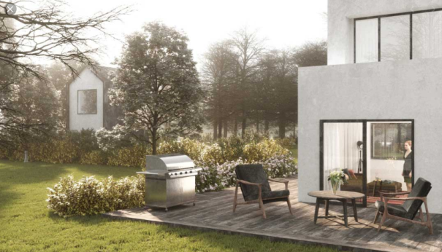
13.4 Computer Animation
What does Rendering mean?
Rendering is the process involved in the generation of a two-dimensional or three-dimensional image from a model by means of application programs.
Rendering is mostly used in architectural designs, video games, and animated movies, simulators, TV special effects and design visualization.
The techniques and features used vary according to the project. Rendering helps increase efficiency and reduce cost in design.
计算机专业英语
1-<number>

Slide 48
13.4 Computer Animation
General Computer-Animation Functions
Another typical function simulates camera movements.
Standard motions are zooming, panning, and tilting.
Finally, given the specification for the key frames, the in-betweens can be automatically generated.
通用计算机动画功能
另一种典型功能是模拟照相机的运动，标准的运动有拉镜头、摇镜头和倾斜。最后，给出对关键帧的描述，然后自动生成插值帧。
计算机专业英语
1-<number>

Slide 49
English For
Computer Science
Chapter 14 Virtual Reality
wxiaotian@jnu.edu.cn

Slide 50
14.1 An Introduction to and History of Virtual Reality
New Words & Expressions:
presentation 陈述，表达 multisensory adj. 多感官的
perspective 透视图，观点 illusion n. 幻想
image 影像，图像 inherently 天性地，固有地
six-surface Cube 六面体 real-time 实时的
stereo 立体的，立体感觉的 resolution n.. 分辨率
mount v. 装配，安装 release v. 释放，放弃
depth cue 深度暗示 projected adj. 投影的
visual adj. 视觉的 simulation n. 模拟
Abbreviations:
VR (Virtual Reality) 虚拟现实
BOOM(Binocular Omni-Orientation Monitor) 双目全方位监视器
HMD (head-mounted display) 头盔显示器
计算机专业英语
1-<number>

Slide 51
14.1 An Introduction to and History of Virtual Reality
One definition of virtual reality is a wide-field presentation of computer-generated, multisensory information that tracks a user in real time. This definition is used at the Electronic Visualization Laboratory in Chicago (EVL).
In other words, virtual reality means that the user is surrounded by a computer-generated image that changes depending on the user movements.
虚拟现实的定义之一：虚拟现实是对由计算机生成的、能够实时追踪用户的多感官信息的一种笼统表述。芝加哥电子可视化实验室（EVL）采用的就是这种定义。
换句话说，虚拟现实意味着用户被计算机生成的图景所包围，这些图景要依据用户的运动而产生变化。
计算机专业英语
1-<number>

Slide 52
14.1 An Introduction to and History of Virtual Reality
The first attempt at virtual reality used head-mounted displays (HMDs).
In HMDs, projectors feed real-time images to small screens attached inside a kind of helmet that the user wears.
In the beginning, HMDs often showed mono(单一) pictures, and the user’s head movements were tracked.
虚拟现实首次尝试使用了头盔式显示器（HMD）。在HMD中，投影机把实时图景投影到附着于用户所带头盔内的小屏幕上。最初，HMD显示平面图片，追踪用户的头部运动。
计算机专业英语
1-<number>

Slide 53
14.1 An Introduction to and History of Virtual Reality
In modern HMDs, stereo pictures are standard, since the technique has become cheaper.
Typically, HMDs either have poor resolution or are too heavy. Because only one person at a time can use an HMD, discussion of images is much more difficult.
但在现代HMD中，由于这项技术变得更加便宜，立体图片则成为了标准。通常说来，HMD或者分辨率过低或者过于笨重。由于一个HMD一次只能由一个人使用，因此对图景的讨论就更加困难。
计算机专业英语
1-<number>

Slide 54
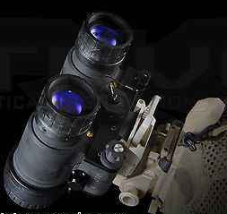
14.1 An Introduction to and History of Virtual Reality
To increase image quality, Fakespace invented the BOOM (Binocular Omni-Orientation Monitor).
Very small monitors are mounted on a mechanical arm, and users look into the monitors like they would look into a pair of binoculars.
为了提高图景的质量，Fakespace发明了BOOM（双目全方位监视器）。机械臂上固定着非常小的监视器，就象使用双目望远镜一样，用户使用监视器观察。
计算机专业英语
1-<number>

Slide 55
14.1 An Introduction to and History of Virtual Reality
Tracking occurs when the user moves the arm, which changes the perspective.
When a user releases the BOOM, another person can look at the same thing from the same perspective, which is an advantage over HMDs. Since real monitors are used, the resolution is good.
用户移动机械臂时改变了视角，因此实现了追踪。当一个用户不用这个BOOM后，另一个用户可以从相同的视角观察到相同的事物，这一点BOOM要优于HMD。因为使用了真正的监视器，所以分辨率很好。
计算机专业英语
1-<number>

Slide 56
14.1 An Introduction to and History of Virtual Reality
The concept of a room with graphics projected from behind the walls was invented at EVL in 1992.
The images on the walls are usually in stereo to give a depth cue.
具有墙后投影生成图像的房间的概念是1992年在EVL发明的。墙上的图景通常是立体的以便能表现出深度。
计算机专业英语
1-<number>

Slide 57
14.1 An Introduction to and History of Virtual Reality
The main advantage over ordinary graphics systems is that the users are surrounded by the projected images, which means that the images are the users’main field of vision.
This is usually called a “CAVE”,CAVE Automatic Virtual Environment. The first CAVE(as well as the concept) was created by the faculty, staff, and students at EVL.
与普通的图形系统相比，它的主要优势在于用户被投影图像所包围，这意味着这些图景是用户的主要视野。
它通常被称为CAVE，即洞穴式自动虚拟环境。第一台CAVE（与其概念）是由EVL的全体教职员和同学共同创造的
计算机专业英语
1-<number>

Slide 58
14.2 About VRML
New Words & Expressions:
interactive 交互的 intranet n. 企业内部互联网
integrate 使成整体，结合 visualization n. 可视化
presentation n. 演示 virtual adj. 虚拟的
criteria 准则 authorability n, 创作性
compose 组成，写作，排字 re-usability n. 可重用性
extensibility 可扩展性 explicitly 明白地，明确地
platform 平台 arbitrarily 武断地，任意地
static 静态的 animated 动画的，活生生的
dynamic 动态的 hyperlink 超级联接
author v. 制作 available 可利用的
registration 注册，登记 community 团体，公用
interoperable 能共同使用的 extension n. 延长，范围
scope 范围 specification 规范，说明书
计算机专业英语
1-<number>

Slide 59
14.2 About VRML
New Words & Expressions:
conceptually 概念地 aural 听觉的
modify 更改，修改 mechanisms 机制
primary 原始的 composition 合成法，排版
encapsulation 封装 semantic 语义
resolution 分辨率 latitude 纬度，范围，地区
interpretation 解释，阐明 mouse 鼠标
implicitly 含蓄地，暗中地 coordinate 坐标
recursively 递归地，回归地 sphere 球体
reference 提及，参考书目 enclose 放入，封闭，包装
hierarchical 分层的，层次的 spatial adj. 空间的
accumulation 积聚，积累 dissipate v. 使消失，失去
intractable 难处理的 compact 紧凑的，简洁的
syntax n. 语法
计算机专业英语
1-<number>

Slide 60
14.2 About VRML
Abbreviations :
VRML (The Virtual Reality Modeling Language) 虚拟现实建模语言
API (application programmer interface) 应用程序界面
计算机专业英语
1-<number>

Slide 61
14.2 About VRML
The Virtual Reality Modeling Language (VRML) is a file format for describing interactive 3D objects and worlds.
VRML is designed to be used on the Internet, intranets, and local client systems. VRML is also intended to be a universal interchange format for integrated 3D graphics and multimedia.
VRML may be used in a variety of application areas such as engineering and scientific visualization, multimedia presentations, entertainment and educational titles, web pages, and shared virtual worlds.
虚拟现实建模语言(VRML)是一种描述交互式三维对象及客观世界的文件格式。VRML用于Internet、Intranet和局域客户系统。VRML也是组合三维图形和多媒体的通用转换格式。VRML的应用领域很广，包括工程、科学可视化、多媒体演示、娱乐教育、Web页面和共享虚拟世界等方面。
计算机专业英语
1-<number>

Slide 62
14.2 About VRML
14.2.1 Design Criteria
VRML has been designed to fulfill the following requirements:
Authorability
Enable the development of computer programs capable of creating, editing, and maintaining VRML files, as well as automatic translation programs for converting other commonly used 3D file formats into VRML files.
14.2.1 设计标准
VRML需要满足如下要求：
创作性
使得应用程序能够建立、编辑、保存VRML文件，也是一个自动翻译程序，能够将通常使用的3D文件格式转换成VRML文件。
计算机专业英语
1-<number>

Slide 63
14.2 About VRML
● 14.2.1 Design Criteria
Composability
Provide the ability to use and combine dynamic 3D objects within a VRML world and thus allow re-usability.
Extensibility
Provide the ability to add new object types not explicitly defined in VRML.
重构性
能够在VRML环境中使用和组合动态3D对象，并允许重用。
扩展性
能够加入在VRML中没有明确定义的新的对象类型。
计算机专业英语
1-<number>

Slide 64
14.2 About VRML
● 14.2.1 Design Criteria
Implementability
Capable of implementation on a wide range of systems.
Performance
Emphasize scalable, interactive performance on a wide variety of computing platforms.
Scalability
Enable arbitrarily large dynamic 3D worlds.
适用性
能够在各种系统中使用。
性能
在各种不同的计算机平台上强调可扩展的、交互的性能。
可扩展性
适于任意大的动态三维世界。
计算机专业英语
1-<number>

Slide 65
14.2 About VRML
14.2.2 Characteristics of VRML
VRML is capable of representing static and animated dynamic 3D and multimedia objects with hyperlinks to other media such as text, sounds, movies, and images.
VRML browsers, as well as authoring tools for the creation of VRML files, are widely available for many different platforms.
VRML的特性
VRML能表示静态及动态的三维和多媒体对象，并通过超链接连到诸如文本、声音、电影及图像等其它媒体。VRML浏览器，同制作VRML文件的制作工具一样，广泛应用于许多不同的平台上。
计算机专业英语
1-<number>

Slide 66
14.2 About VRML
14.2.2 Characteristics of VRML
VRML supports an extensibility model that allows new dynamic 3D objects to be defined and a registration process that allows application communities to develop interoperable extensions to the base standard.
There are mappings between VRML objects and commonly used 3D application programmer interface (API) features.
VRML支持扩展模式，即允许创建新的3维动态对象，并允许应用程序组开发在基础模式上加以扩展的可共同操作的文件。在VRML对象和通常使用的应用程序接口特性间有相应的映射。
计算机专业英语
1-<number>

Slide 67
14.2 About VRML
14.2.3 Scope
The VRML specification defines a file format that integrates 3D graphics and multimedia.
Conceptually, each VRML file is a 3D time-based space that contains graphic and aural objects that can be dynamically modified through a variety of mechanisms.
VRML defines a primary set of objects and mechanisms that encourage composition, encapsulation, and extension.
领域
VRML规范定义了一种可将3D图形和多媒体结合起来的文件格式。总体上，每个VRML文件是3维时间依赖空间，包含能够通过不同机制动态修改的图像和音频对象。VRML定义了一个对象的初始集，并允许将对象进行合成、封装和扩充。
计算机专业英语
1-<number>

Slide 68
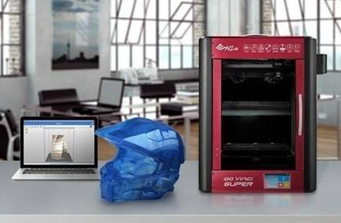
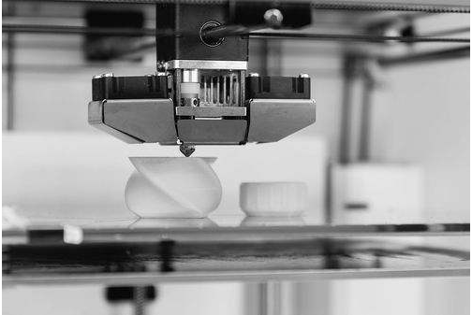
3D printing, also known as additive manufacturing (AM), refers to processes used to synthesize a three-dimensional object in which successive layers of material are formed under computer control to create an object.
三维打印，也被认为是增材制造，是用于合成一个三维物体的处理过程，在该物体里，连续的材料层是在计算机控制下形成的。
计算机专业英语
1-<number>

Slide 69
Objects can be of almost any shape or geometry and are produced using digital model data from a 3D model or another electronic data source such as an Additive Manufacturing File (AMF).
物体可以几乎是任何的形状或几何模型，使用数字模型数据产生，这些数字模型数据来自三维模型或者如增材制造文件等的另一种电子数据源。
video
3D Printing:
http://v.youku.com/v_show/id_XNTU4Nzk0NjUy.html?spm=a2h0k.8191407.0.0&from=s1.8-1-1.2
SIGGRAPH
http://v.youku.com/v_show/id_XMTU3MzE3NzM5Mg==.html?spm=a2h0k.8191407.0.0&from=s1.8-1-1.2
http://v.youku.com/v_show/id_XMTQ4MTQ4MTM2OA==.html?spm=a2h0k.8191407.0.0&from=s1.8-1-1.2
计算机专业英语
1-<number>

